Slide 1
EmpowHer
EmpowHER: Empowering Girls for Corporate Excellence Technical Curriculum Python

Slide 2
Agenda
Installation Overview

Slide 3
Installation Overview
Install Python
Install Visual Studio Code
Configuring Python interpreter in VS Code

Slide 4
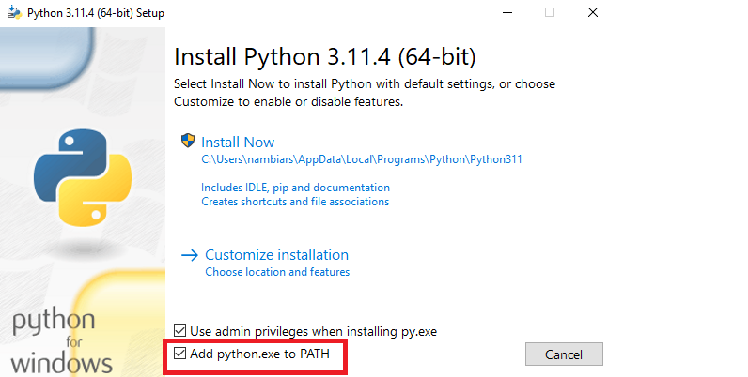
Install Python
Click the download link depending on your system (64bit , 32bit ) for the latest version of python
Open the python installer and select the “Add python.exe to PATH” checkbox and click Install now
Close once the installation is completed

Slide 5
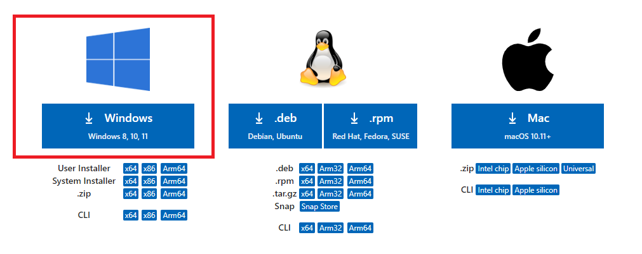
Install VS Code
Go to the download link and click the windows download icon
Open the VS Code installer and click “I accept the agreement” then Next checkbox and click Install now
Click Next until Install button appears then click install
Once installation is done close the installer and open the installed visual studio code app

Slide 6
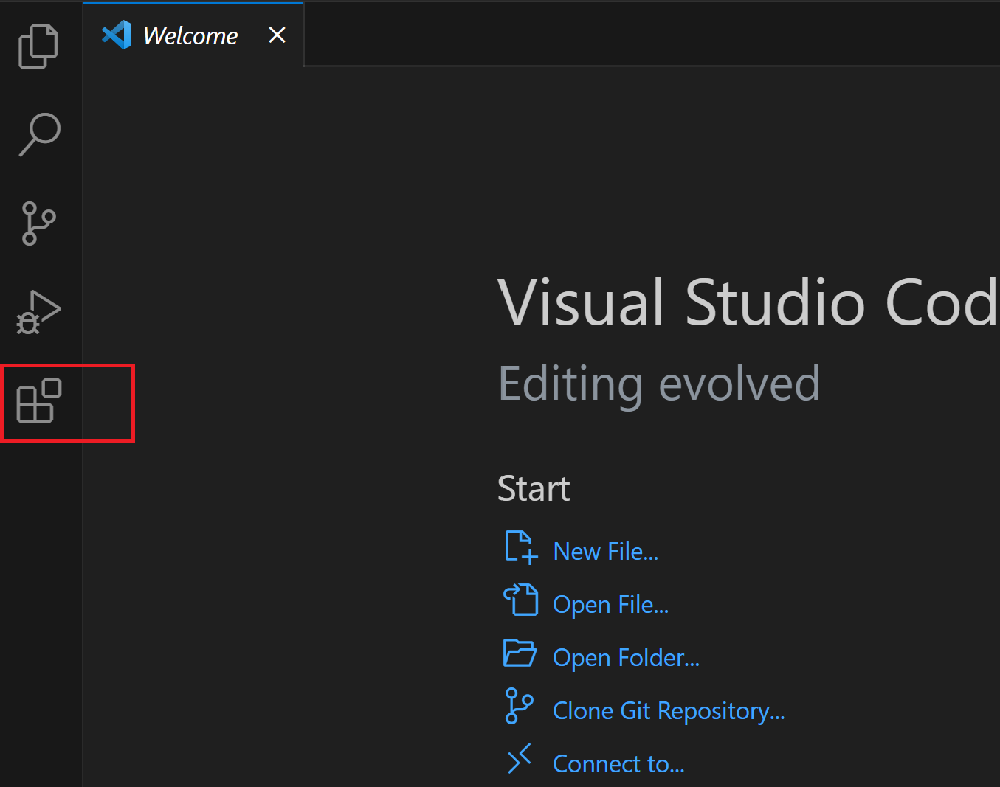
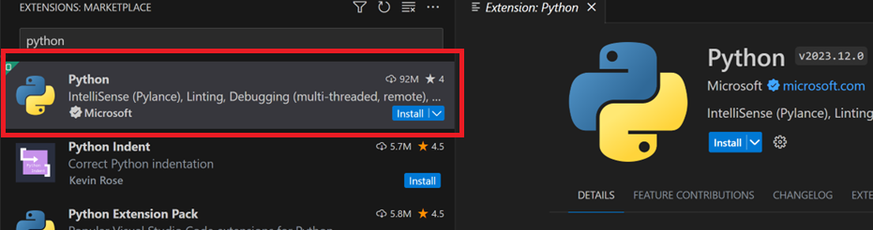
Install Python interpreter in VS Code
Open VS Code
Click on the “Extensions” Icon from the left side bar
Type “Python” in the search box and click the first search result
Click install

Slide 7
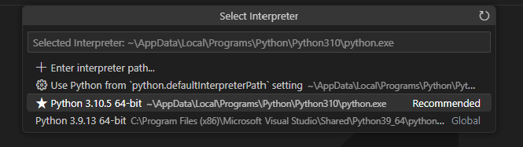
Install Python interpreter in VS Code
Press Shift+Ctrl+P simultaneousl,y a window will pop up
Type “Python Interpreter” and click the first search result
Select the installed python interpreter path

Slide 8
Topic Week 2

Slide 9
Agenda Week 3
Tip: Use infographics,
Smart Art,
Images/Screens,
Embed relevant learning videos/case study

Slide 10
Topic Week 3

Slide 11
Agenda Week 4
Tip: Use infographics,
Smart Art,
Images/Screens,
Embed relevant learning videos/case study

Slide 12
Topic Week 4

Slide 13
Agenda Week 5
Tip: Use infographics,
Smart Art,
Images/Screens,
Embed relevant learning videos/case study

Slide 14
Topic Week 5

Slide 15
Agenda Week 6
Tip: Use infographics,
Smart Art,
Images/Screens,
Embed relevant learning videos/case study

Slide 16
Topic Week 6

Slide 17
Agenda Week 7
Tip: Use infographics,
Smart Art,
Images/Screens,
Embed relevant learning videos/case study

Slide 18
Topic Week 7

Slide 19
Agenda Week 8
Tip: Use infographics,
Smart Art,
Images/Screens,
Embed relevant learning videos/case study

Slide 20
Topic Week 8

Slide 21
Agenda Week 9
Tip: Use infographics,
Smart Art,
Images/Screens,
Embed relevant learning videos/case study

Slide 22
Topic Week 9

Slide 23
Agenda Week 10
Tip: Use infographics,
Smart Art,
Images/Screens,
Embed relevant learning videos/case study

Slide 24
Topic Week 10

Slide 25
Appendix
Add Links or permissible Images as needed

